Slide 1
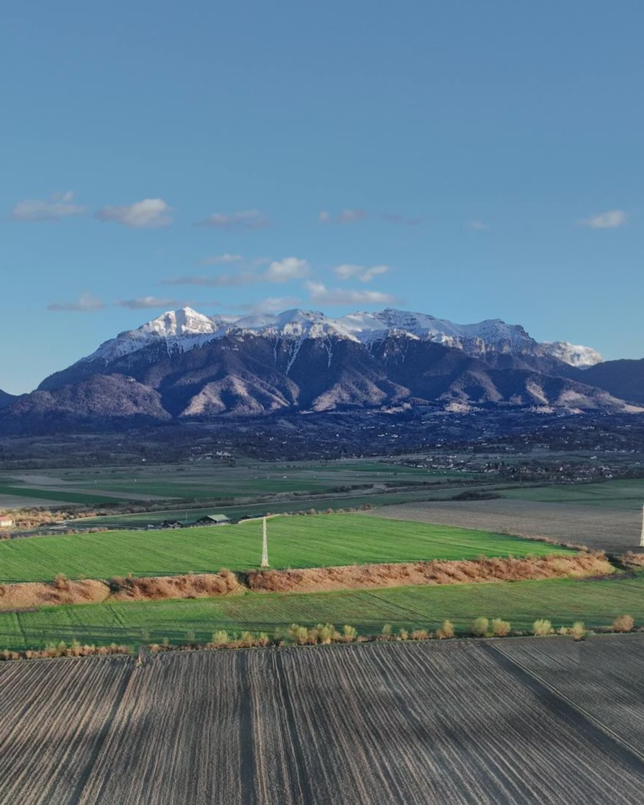

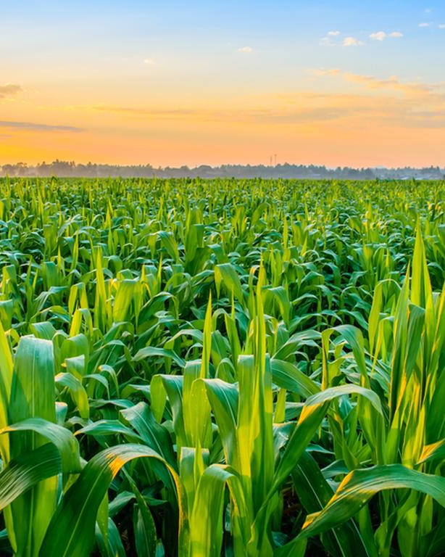
Company Name
“LOGO”

Slide 2
Executive Summary
Brief Company Overview
Brief Project Overview:
Type of Project: Greenfield or Brownfield
Segment
How your project aligns with the Key Sectors for Pak-China Agri-Investment Conference
Investment Ask
1

Slide 3
Company Overview
Company Profile & Track Record: Core activity
Years in operation and current market standing in Pakistan.
Key certifications held to prove international compliance.
Current Infrastructure & Assets:
Land/Project/Capacity: (e.g: Total acreage under management or factory processing throughput)
Value Chain: Scope of operations
What you provide: Local land, established labor force, and deep regulatory/government relations,
Export Centricity: Your readiness to scale production to meet Chinese quality standards for future export.
2

Slide 4
Project Overview
Project Definition & Location
Specific venture name and core activity (e.g., "High-Yield Rice Processing & Value-Addition Hub").
Strategic site location (e.g., "CPEC North Zone / M-1 Motorway proximity") and site readiness status.
Technology & Innovation Focus
Identification of the specific Chinese technology sought (e.g., "Smart climate-controlled silos" or "Automated extraction lines").
Clear "Value-Addition" goal (e.g., "Transforming raw harvest into export-grade derivatives").
Operational Targets & Timeline
Targeted production capacity (e.g., "Annual throughput of 100,000 Metric Tons").
Phased roadmap: Commissioning (Q3 2026) → Full Production (Q1 2027).
Economic & Strategic Impact
Quantifiable impact on import substitution or foreign exchange earnings.
Sustainability metrics (e.g., "30% water reduction via Chinese drip-irrigation tech").
3

Slide 5
Financials
Financial Category | Metric | FY 20-- | FY 20-- | FY 20--
Income Statement | Total Revenue (PKR Mn)
 | EBITDA (PKR Mn)
 | Net Income (PKR Mn)
Balance Sheet | Total Assets (PKR Mn)
 | Total Debt (PKR Mn)
 | Shareholder Equity (PKR Mn)
Profitability | Gross Profit Margin (%)
Profitability | EBITDA Margin (%)
 | Return on Equity (ROE)
Liquidity & Risk | Current Ratio (Liquidity)
 | Debt-to-Equity
*Not subjected to just the above line items, add any additional relevant financials
capex
4

Slide 6
Investment Ask
Project Capital Structure:
Total Project Cost: [Total Amount in USD]
Investment Ask: [Amount] (Equity, Debt)
Local Sponsor Contribution: [Amount] (Land, Infrastructure, or Cash)
Utilization of Funds (CAPEX focus):
Technology Acquisition: [X%]
Infrastructure & Civil Works: [X%]
Working Capital: [X%]
Financial Benchmarks & ROI:
Projected IRR: [X%] | Payback Period: [X] Years
Growth Milestones (The Roadmap):
Phase 1 (6–12 Months):
Phase 2 (12–24 Months):
Phase 3 (24+ Months):
Description | PKR Mn
Sponsor Contribution
Raising from Investors
Total Funds Required
5

Slide 7
Contact
Name
Designation
Contact information
E mail:
Cell:
WeChat: (If applicable):
1

